Slide 1

Bias Variance Trade-off
Speaker: Abhishek Parikh, Software Engineer, InFoCusp
Email Id: abhishek@infocusp.in
Linked In: https://www.linkedin.com/in/parikhabhi007/

Slide 2
Bias-Variance Trade-off
In machine learning and statistics, a fit refers to how well you approximate a function.
The terminology is in accordance with the Supervised Learning Algorithms, which tries to approximate the unknown underlying mapping function for the output variables given the input variables.
“Goodness of Fit”: How well your function is approximated.
Cost functions / Error functions are used to calculate the goodness of fit.

Slide 3
Bias-Variance Trade-off
Underfitting: Underfitting refers to a model that can neither model the training data nor generalize the new data.
An Underfit machine learning algorithm is not a suitable model as it will poorly perform on training data and testing data.
Overfitting: Overfitting refers to a model that fits well on the training too well.
Overfitting happens when a model learns the detail and noise in the training data to the extent that it negatively impacts the performance of the model on new data.
This means that the noise or random fluctuations in the training data is picked up and learned as concepts by the model. The problem is that these concepts do not apply to new data and negatively impact the models ability to generalize.

Slide 4
Bias-Variance Trade-off
Bias: Bias are the simplifying assumptions made by a model to make the target function easier to learn.
The bias is an error from erroneous assumptions in the learning algorithm.
They have lower predictive performance on the complex problems that cannot be simplified.
Low Bias: Less assumptions about the target function.
High Bias: More assumption about the target function.
Examples of Low Bias Machine Learning Algorithms: Decision Trees
Examples of High Bias Machine Learning Algorithms: Linear Regression, Logistic Regression

Slide 5
Bias-Variance Trade-off
Variance: Variance is the amount that the estimate of the target function will change if different training data was used.
The variance is an error from sensitivity to small fluctuations in the training set.
Machine learning algorithms that have a high variance are strongly influenced by the specifics of the training data.
This means that the specifics of the training have influenced the number and types of parameters used to characterize the mapping function.
Low Variance: Small changes to the estimate of the target function with changes to the training dataset.
High Variance: Large changes to the estimate of the target function with changes to the training dataset.
Examples of High Variance: Decision Trees

Slide 6
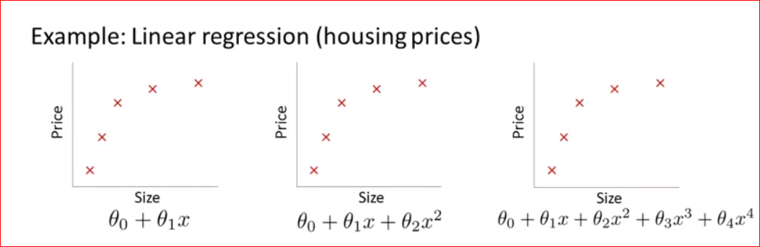
Bias-Variance Trade-off

Slide 7
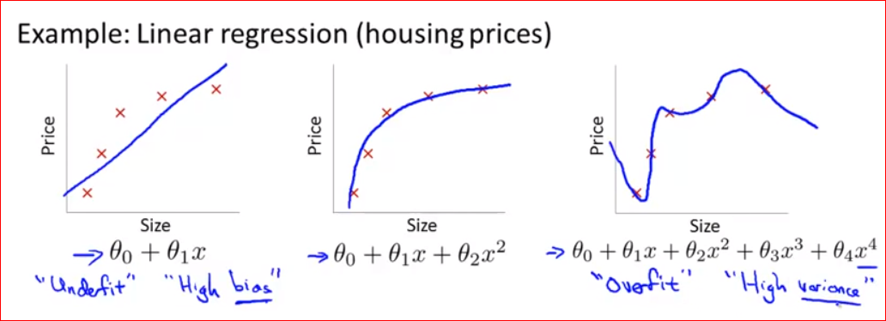
Bias-Variance Trade-off

Slide 8
Bias-Variance Trade-off
A Good Fit in Machine Learning!
There is no escaping the relationship between bias and variance in machine learning.
Increasing the bias will decrease the variance.
Increasing the variance will decrease the bias.
Ideally, one will want to select a model at the sweet spot between underfitting and overfitting and maintain the right balance between Bias and Variance. That’s Bias-Variance tradeoff for you!

Slide 9
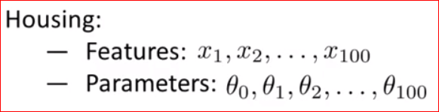
Bias-Variance Trade-off
Let’s talk about features, parameters (weight) etc.
To address the problem of fitting we have few ways:
Select just the perfect set of features.
Select just the right model algorithm.
Regularization

Slide 10
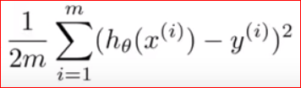
Bias-Variance Trade-off
Regularization:
Keep all the parameters, but reduce the magnitude/values/weight.
Works extremely well when we have a lot of features and each of them contributes to predicting or estimating the output.

Slide 11
Bias-Variance Trade-off
Overfitting:
In Regularization, we penalize the parameters those who are responsible for increasing the error in the prediction.

Slide 12
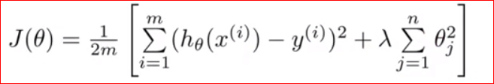
Bias-Variance Trade-off
Lambda: It is called the Regularization Parameter.
It tries to balance or trade-off between two goals: Perform well on training data and keeping hypothesis simple to avoid overfitting.

Slide 13
Bias-Variance Trade-off
Lambda: It is called the Regularization Parameter.
If lambda is set to extremely large value, we end up penalizing all the parameters and we end up with a straight line Y = C₀. This will definitely lead to under-fitting.
If lambda is set to extremely small value, we end up ignoring the regularization term and lead to over-fitting (back to square-one!)

Slide 14
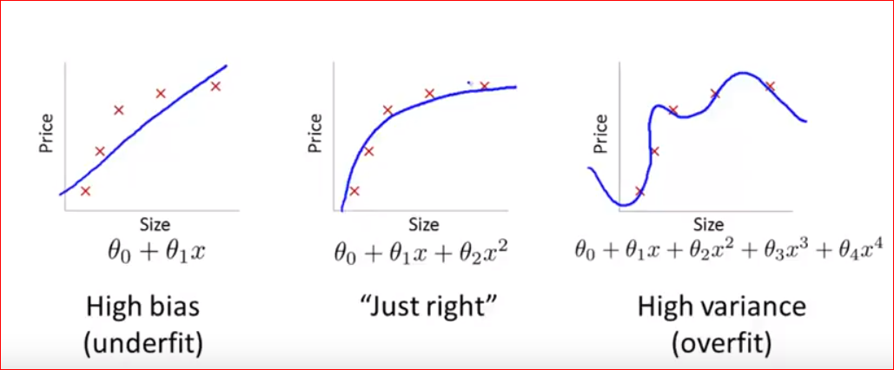
Bias-Variance Trade-off

Slide 15
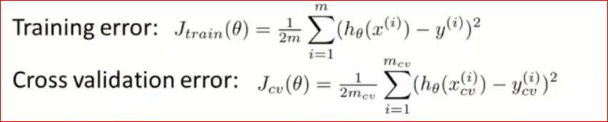
Bias-Variance Trade-off

Slide 16
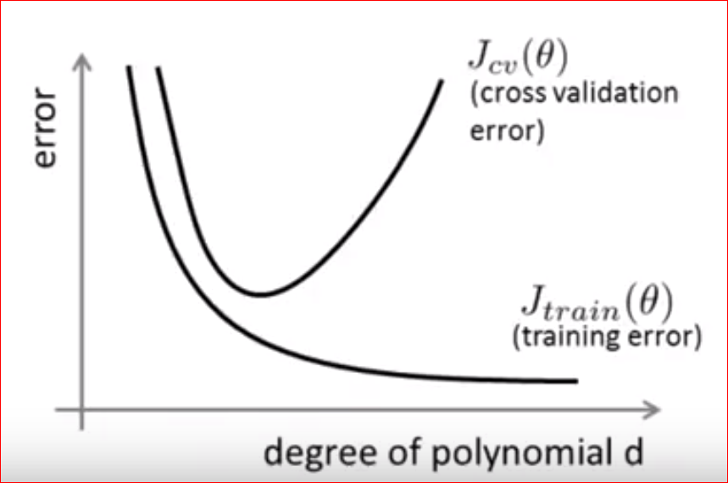
Bias-Variance Trade-off

Slide 17
Bias-Variance Trade-off
Bias Region:
High Training Error
Cross Validation Error == Training Error
Variance Region:
Low Training Error
Cross-validation Error >> Training Error

Slide 18
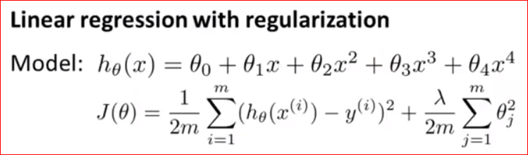
Bias-Variance Trade-off
Effect of Regularization on Bias Variance:

Slide 19
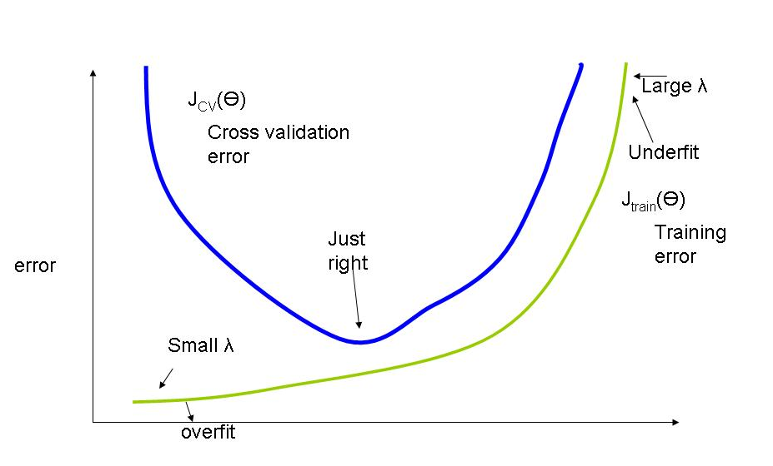
Bias-Variance Trade-off

Slide 20
Deciding What To Try Next!
Suppose you have implemented a supervised learning algorithm, say a linear regression to predict the houses.
You chose certain features, certain parameters and you have the results and you want to know what to try next.
Get more training examples.
Try smaller set of features.
Try getting additional features.
Try adding more polynomial features.
and etc. etc.

Slide 21
Learning Curves

Slide 22
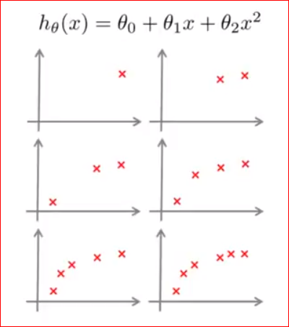
Learning Curves

Slide 23
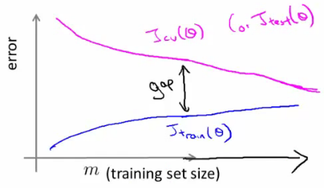
Learning Curves

Slide 24
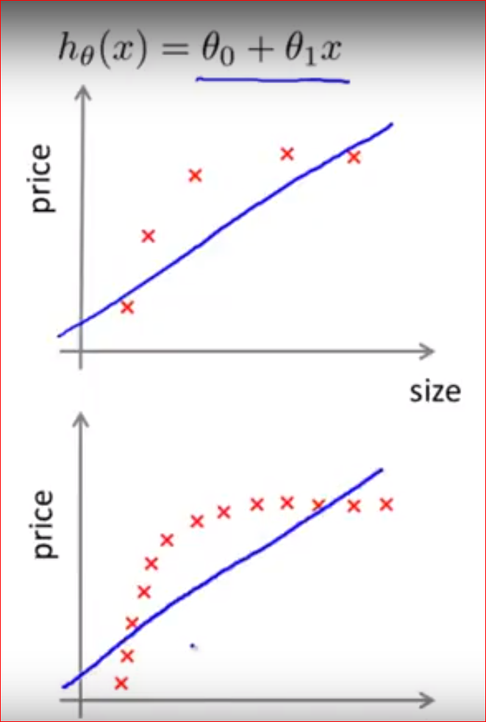
Learning Curves with High Bias

Slide 25
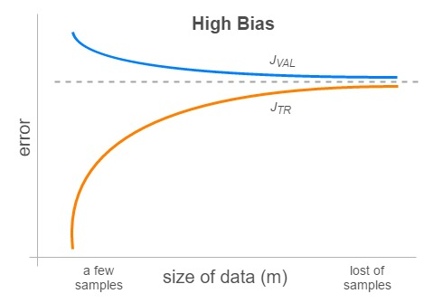
Learning Curves with High Bias

Slide 26
Learning Curve with High Bias
High Bias:
High Training Error
Cross Validation Error == Training Error
More number of example is not going to help much.
Getting more features will help.

Slide 27
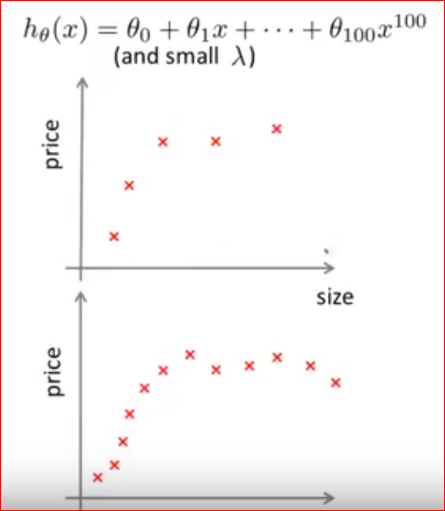
Learning Curves with High Variance

Slide 28
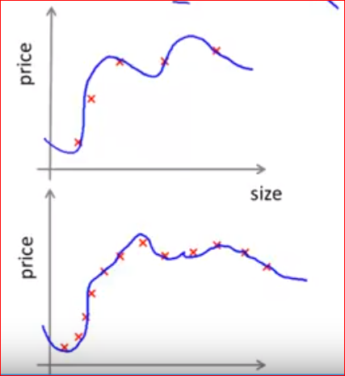
Learning Curves with High Variance

Slide 29
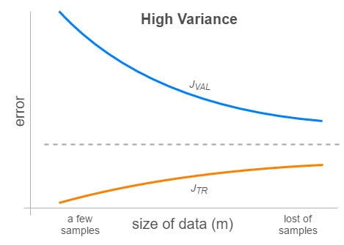
Learning Curves with High Variance

Slide 30
Learning Curve with High Variance
High Variance:
Low Training Error
Cross Validation Error >> Training Error
More number of example is likely to help.
Reducing the feature might also help.

Slide 31
Deciding What To Try Next!
Suppose you have implemented a supervised learning algorithm, say a linear regression to predict the houses.
You chose certain features, certain parameters and you have the results and you want to know what to try next.
Get more training examples.
Try smaller set of features.
Try getting additional features.
Try adding more polynomial features.
Decreasing lambda
Increasing lamba

Slide 32
Deciding What To Try Next!
Which helps what:
Get more training examples. - fixes High Variance
Try smaller set of features. - fixes High Variance
Try getting additional features. - fixes High Bias
Try adding more polynomial features. - fixes High Bias
Decreasing lambda - fixes High Bias
Increasing lamba - fixes High Variance

Slide 33
How to measure a Model performance?
Speaker: Abhishek Parikh, Software Engineer, InFoCusp
Email Id: abhishek@infocusp.in
Linked In: https://www.linkedin.com/in/parikhabhi007/

Slide 34
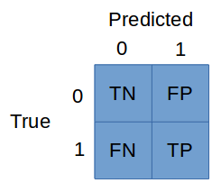
Model Performance Metrics
Confusion Matrix:

Slide 35
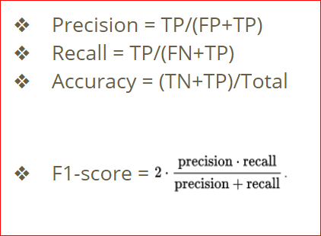
Model Performance Metrics
Confusion Matrix:

Slide 36
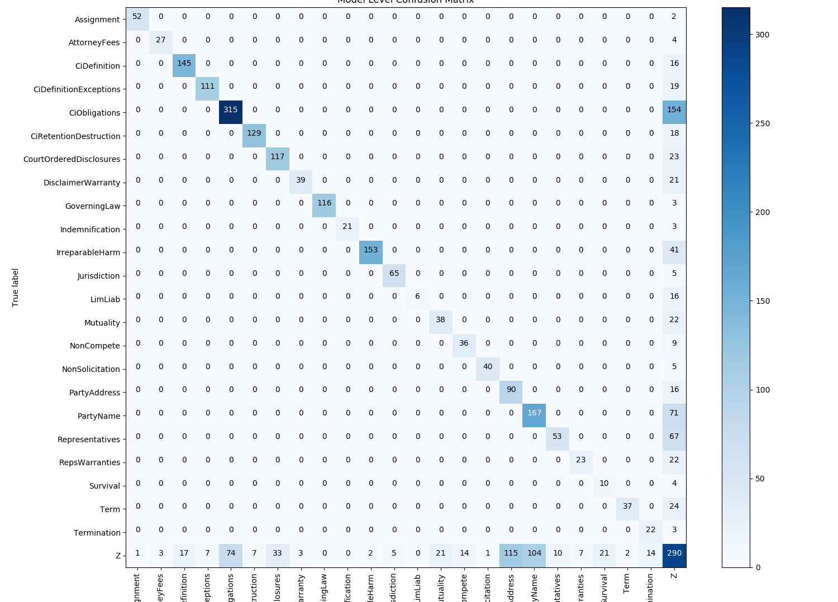
Model Performance Metrics

Slide 37
Model Performance Metrics
Some more metrics:
top-N
scoreX
etc. etc.

Slide 38
Thank you!

